Slide 1


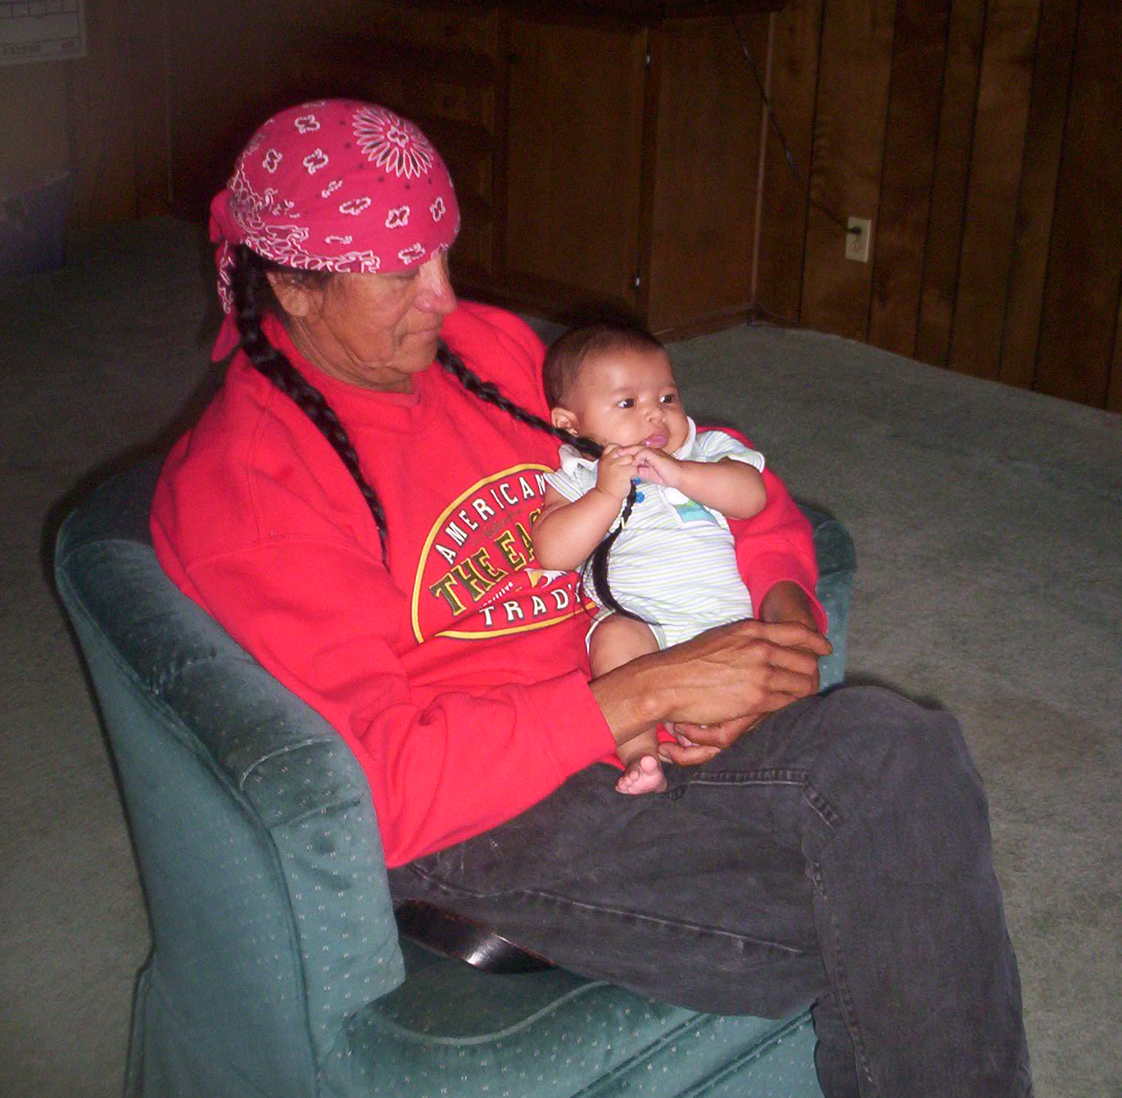


Language Revitalization Begins at Birth:
Supporting Intergenerational Language Development in Early Childhood
ANA Language Summit
November 16-18, 2020
Notes:
Melody
Session Description
This session will highlight current research regarding infant and toddler language acquisition.
Strategies and resources will be shared for expanding language revitalization in early childhood to include infants and toddlers.
Peer to peer sharing between Tribes will be encouraged to support partnerships for connecting language revitalization across the age continuum.

Slide 2
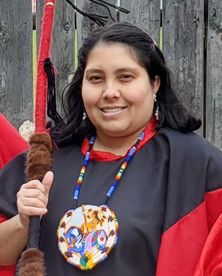

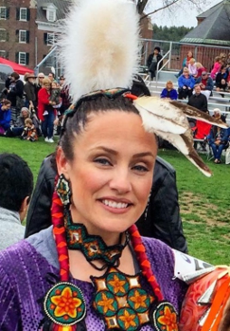
Presenters
Melody
Redbird-Post
Project Director
Technical Assistance
Specialist,
Region I National Center on Tribal Early Childhood Development
Char
Schank
Technical Assistance Coordinator
Technical Assistance
Specialist,
Regions VII & VIII
National Center on Tribal Early Childhood Development
Lisa
Ojibway
Infant Toddler Specialist, Tribal Liaison
Infant Toddler Specialist Network
Child Care State Capacity Building Center
Notes:
Melody
Here are our presenters for today. (presenters introduce themselves)

Slide 3
Session Objectives
Share research regarding language acquisition from birth to 2 years old
Discuss strategies and resources for expanding language revitalization to include an intergenerational approach
Explore partnerships to support language revitalization across early childhood and school-age programs
Notes:
Lisa
Read slide.

Slide 4
Research on Language Acquisition and the Benefits of Bilingualism
Notes:
Lisa
Read slide.

Slide 5

6,909 world languages
Source: Lewis, M. P. (Ed.). (2009). Ethnologue: Languages of the World (16th ed.) SIL International.
http://www.ethnologue.com/16
169 indigenous languages
Source: Siebens, J. & Julian, T. (2011) Native North American Languages Spoken at Home in the United States and Puerto Rico: 2006-2010. United States Census Bureau.
https://www2.census.gov/library/publications/2011/acs/acsbr10-10.pdf
Notes:
Lisa
Read slide. Babies are born with the capacity to speak any of the world’s languages.

Slide 6
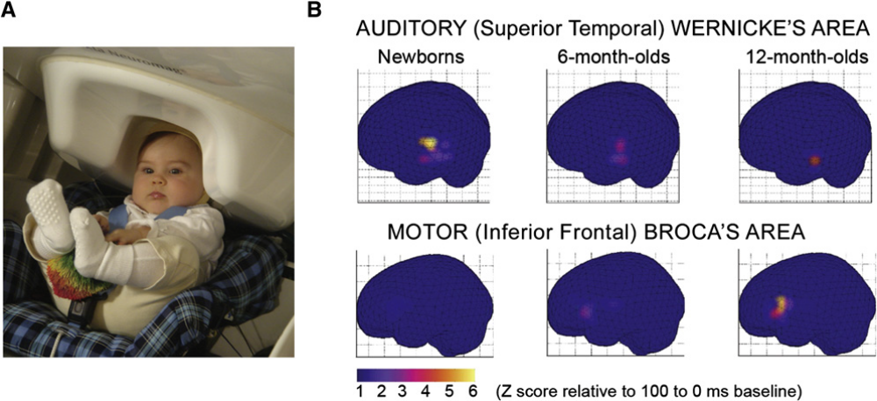
Brain Imaging Studies: Infant/Toddler Cross-Linguistic Speech Perception
Source: Imada, T., Zhang, Y., Cheour, M., Taula, S., Ahonen, A., & Kuhl, P. (2006). Infant speech perception activates Broca’s area: A developmental magnetoenceph-alography study. NeuroReport, 17(10), 957–962.
Notes:
Lisa
As can be seen in the images, the Wernicke ’s Area pertaining to language input shows greatest activity for newborns and then decreases at 6 months of age and then decreases even further at 12 months of age.
Conversely, the Broca’s Area involved in speech output shows almost no activity in newborns and then increased activity by 6 months of age which is in the midst of the babbling stage and further increased activity by 12 months of age when first word production typically emerges.

Slide 7
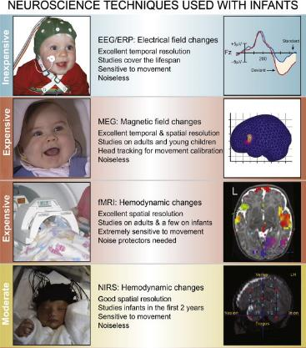
Infant/Toddler Brain Imaging Studies
Brain imaging studies use the following:
Positron Emission Tomography (PET) scans
Magnetoencephalography (MEG)
Functional magnetic resonance imaging (fMRI)
Near-infrared Spectroscopy (NIRS) (used to examine the infant/toddler brain activity responses to linguistic stimuli)
Figure 1: Four techniques now used extensively with infants and young children to examine their responses to linguistic signals. Source: Kuhl, P., & Rivera-Gaxiola, M. (2008). Neural substrates of language acquisition. Neuroscience, 31, 511–534.
Notes:
Lisa
There have been numerous infant brain imaging studies conducted and they use different neuroscience techniques illustrated below:
Positron Emission Tomography (PET) scans
Magnetoencephalography (MEG)
functional Magnetic Resonance Imaging (fMRI)
Near-infrared Spectroscopy (NIRS) have been utilized to examine the infant and toddler brain activity responses to linguistic stimuli.
Video Clip example of MEG scan - https://www.youtube.com/watch?v=k9kD3PETt8w
Cross-linguistic brain imaging studies can determine whether or not the infant brain is treating the linguistic input as simply auditory sound or specifically recognizing languages (including languages they’ve never heard before) as speech.
Attention to the specific areas of brain activity such as activity in the left angular gyrus can also indicate whether or not the test subjects recognize the linguistic input as words or non-words.
Brain imaging studies including Positron Emission Tomography (PET) scans, Magnetoencephalography (MEG), and functional magnetic resonance imaging (fMRI) have been utilized to examine the infant and toddler brain activity in responses to linguistic stimuli.

Slide 8
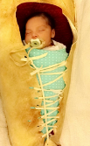

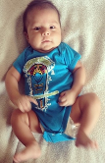
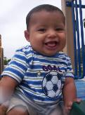

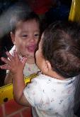
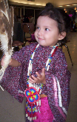
Language Acquisition Birth to 2 years
Newborn
2 months
4 months
6 months
9-14 months
14-20 months
8 months
Notes:
Lisa (5mins)
Intergenerational aspects – infants, older children, parents, grandparents
Community partnerships with broffebrenner’s ecologcial systems theory
Hearing develops in utero by the 6th-7th month of pregnancy. Dr. T. Berry Brazelton found that newborns at birth turn their head to the voice of their parent vs. pediatrician (they turn to the voice they know and have heard in utero)
2 months of age Research identified that at 2 months of age, babies can match vowels they hear with the corresponding lip movements. They are lip reading, studying and mimicking facial expressions, matching sounds to linguistic input, phonetic detail)
6 month infants produce universal sounds when babbling . De Boysson-Bardies, B. (2001). How language comes to children: Birth to 2 years old. MIT Press.
8 months language specific babbling. Research by De Boysson-Bardies, B. (2001) babbling and first words of infants from Japan, England, France and Sweden were different as the babies begin to utilize the sounds of their particular language. De Boysson-Bardies, B. (2001). How language comes to children: Birth to 2 years old. MIT Press.
9–14 months of age babbling becomes language-specific. Infants/toddlers from Algeria, England, China, and France babble differently replicating the phonetic units used in their native language.
14–20 months old, brain activity in response to linguistic input settles in the Broca’s and Wernicke’s language processing areas of the brain. Mills, D.L., Prat, C., Zangl, R., Stager, C.L., Neville, H.J., & Werker, J.F. (2004). Language experience and the organization of brain activity to phonetically similar words: ERP evidence from 14- and 20- month-olds. Journal of Cognitive Neuroscience. Volume 16 (8), 1452-1464.
As a newborn… you enter into a family that could speak any of the distinct languages that exist today.
Babies go from no language….. to becoming fully FLUENT in any language in the world…. within 2 years….. How do they do this?
In the interest of time I will highlight one researcher and key piece of information
According to Dr. Patricia Kul - The world's languages contain around 600 consonants and 200 vowels however, each language uses a unique set of roughly 40 phonemes
Research indicates that Infants’ sensitivity to phonetic detail helps them identify the 40 distinct phonemes of their ambient language.
From there they begin to replicate sounds, parse words, map words and increase their knowledge base to first word production and vocabulary expansion.
We lose this ability or cognitive-linguistic superpower as we begin to master our dominant language.
This is one example of the research on language acquisition birth to 2 years old in which babies are truly the champions of learning any language in the world more quickly than adults, becoming fluent, and….. with accuracy.
In Utero, hearing develops by the 6th-7th month of pregnancy……
Newborns, just minutes old turn their head to the familiar voice… the parent's voice that they heard while they were in the womb.
Hotelling, B. (2004) Newborn Capabilities: Parent Teaching Is a Necessity. Journal of Perinatal Education 2004 Fall; 13(4): 43–49.
Research from Patterson and Werker identified that at 2 months of age, babies also watch and eye tracking indicated that they match the sounds they hear (phonetic information) with the corresponding lip movements of any language being spoken.
Patterson, M. L., and Werker, J. F. (2003). Two-month-old infants match phonetic information in lips and voice. Developmental Science, 6(2), 191-196.
De Boysson-Bardies, B., and Vihman studied and analyzed the babbling of infants from different language backgrounds and countries around the world and found that at
6 months of age universal babbling
8 months of age variegated babbling emerges and infants from different language backgrounds (English, French, Japanese and Swedish) had statistically significant differences in the babbling.
9–14 months of age babbling becomes language-specific. Infants/toddlers from Algeria, England, China, and France babble differently.
De Boysson-Bardies, B., and Vihman, M. (1991). Adaptation to Language: Evidence from Babbling and First Words in Four Languages. Language, 67(2), 297-319. doi:10.2307/415108.
Brain imaging studies found that the brain activity of 14-20 months old infants’ in response to linguistic input settles in the Broca’s and Wernicke’s language processing areas of the brain.
Broca’s Area lights up / shows activation when you are talking or producing speech (both spoken language and sign language)
Wernicke’s Area lights up during language comprehension. When a baby’s brain is processing this as language whether it’s spoken language or sign language).
Since you can’t ask a baby in different languages “do you understand what I’m saying in different languages?” the brain imaging studies show how the infant/toddler brain processing the information as language.
If it were heard as arbitrary sound like a bell or a dog barking the brain activity would be in the temporal lobe which processes sound……… but the research and brain imaging studies showed activation in the Wernicke’s Language Processing Area of the brain.
This 14-20 month age-range coincides with the time-frame in which infants typically produce words, expand their vocabulary, and develop of sentences.
Mills, D.L., Prat, C., Zangl, R., Stager, C.L., Neville, H.J., & Werker, J.F. (2004). Language experience and the organization of brain activity to phonetically similar words: ERP evidence from 14- and 20- month-olds. Journal of Cognitive Neuroscience. Volume 16 (8), 1452-1464
So babies are truly the champions of learning any language in the world more quickly than adults, becoming fluent, and….. with accuracy.

Slide 9
Poll / Discussion Question
What age ranges does your Tribe involve in language revitalization efforts?
How does your Tribe or community strengthen or support language revitalization?
Notes:
Lisa
Ages: What age ranges does your Tribe involve in language revitalization efforts?
How does your Tribe or community strengthen or support language revitalization?

Slide 10
Strategies for an Intergenerational Approach
Notes:
Melody

Slide 11
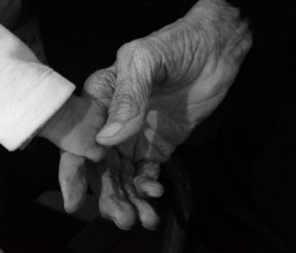
An Intergenerational Approach
“As sovereign nations, AI/AN communities have been addressing issues of Native language and culture revitalization for many years.”
Source: Office of Planning, Research & Evaluation. (2020). Home and Community Native Language and Cultural Experiences Among AI/AN Children in Region XI Head Start: Findings from the American Indian and Alaska Native Head Start Family and Child Experiences Survey 2015. U.S. Department of Health and Human Services, Administration for Children and Families. https://www.acf.hhs.gov/opre/resource/home-and-community-native-language-and-cultural-experiences-among-ai-an-children-in-region-xi-head-start
Notes:
Melody
Read slide.

Slide 12
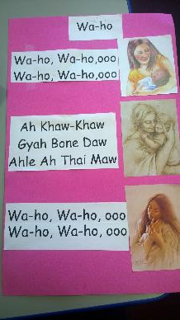
An Intergenerational Approach
“More recent understandings of the importance of supporting Native language development in the early years and the role of early childhood education in this process have led to a shift toward supporting early childhood programs as allies to Native language revitalization efforts.”
Source: Office of Planning, Research & Evaluation. (2020). Home and Community Native Language and Cultural Experiences Among AI/AN Children in Region XI Head Start: Findings from the American Indian and Alaska Native Head Start Family and Child Experiences Survey 2015. U.S. Department of Health and Human Services, Administration for Children and Families. https://www.acf.hhs.gov/opre/resource/home-and-community-native-language-and-cultural-experiences-among-ai-an-children-in-region-xi-head-start
Notes:
Melody
Read slide.

Slide 13

An Intergenerational Approach
“Research has found that AI/AN teen parents who have strong cultural connections are more likely to have positive parenting and family functioning and less likely to engage in substance use (Barlow et al., 2010).”
Source: Office of Planning, Research & Evaluation. (2020). Home and Community Native Language and Cultural Experiences Among AI/AN Children in Region XI Head Start: Findings from the American Indian and Alaska Native Head Start Family and Child Experiences Survey 2015. U.S. Department of Health and Human Services, Administration for Children and Families. https://www.acf.hhs.gov/opre/resource/home-and-community-native-language-and-cultural-experiences-among-ai-an-children-in-region-xi-head-start
Notes:
Melody
Read slide.

Slide 14
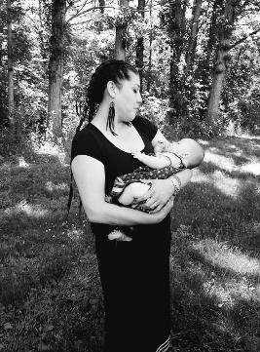
An Intergenerational Approach
“Home- and center-based early childhood education and care programs such as Home Visiting, Head Start, and Child Care can support the inclusion of Native language and culture in the programs’ home-to-school connection efforts. These programs are in a unique position to get to know families and build upon families’ specific cultural strengths (see Sarche et al., 2020).”
Source: Office of Planning, Research & Evaluation. (2020). Home and Community Native Language and Cultural Experiences Among AI/AN Children in Region XI Head Start: Findings from the American Indian and Alaska Native Head Start Family and Child Experiences Survey 2015. U.S. Department of Health and Human Services, Administration for Children and Families. https://www.acf.hhs.gov/opre/resource/home-and-community-native-language-and-cultural-experiences-among-ai-an-children-in-region-xi-head-start
Notes:
Melody
Read slide.

Slide 15
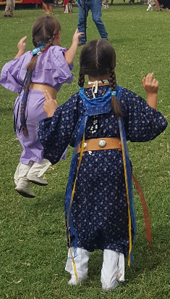
An Intergenerational Approach
“Focusing on cultural strengths has the potential to build trust and provide opportunities for collaboration between families and program staff to support young children’s engagement with Native language and cultural practices.”
Source: Office of Planning, Research & Evaluation. (2020). Home and Community Native Language and Cultural Experiences Among AI/AN Children in Region XI Head Start: Findings from the American Indian and Alaska Native Head Start Family and Child Experiences Survey 2015. U.S. Department of Health and Human Services, Administration for Children and Families. https://www.acf.hhs.gov/opre/resource/home-and-community-native-language-and-cultural-experiences-among-ai-an-children-in-region-xi-head-start ​
Notes:
Melody
Read slide.

Slide 16
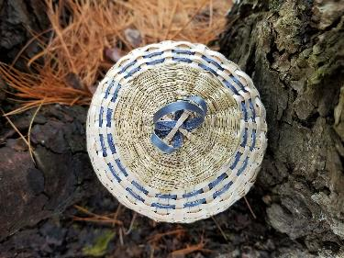
An Intergenerational Approach
“Connecting AI/AN children and families with their Native language and cultural practices supports a world view that promotes cognitive, physical, and emotional well-being for children, their families, and the staff working in AI/AN communities.”
Source: Office of Planning, Research & Evaluation. (2020). Home and Community Native Language and Cultural Experiences Among AI/AN Children in Region XI Head Start: Findings from the American Indian and Alaska Native Head Start Family and Child Experiences Survey 2015. U.S. Department of Health and Human Services, Administration for Children and Families. https://www.acf.hhs.gov/opre/resource/home-and-community-native-language-and-cultural-experiences-among-ai-an-children-in-region-xi-head-start ​
Notes:
Melody
Read slide.

Slide 17
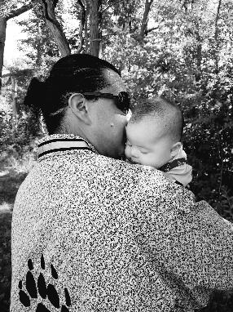
An Intergenerational Approach
“I believe that in our language and culture we find the strength and resiliency that have allowed our people to survive to now. And I think that through that, we will continue to thrive as Tribal Nations.”
~ Tribal early childhood education program administrator
Source: Office of Planning, Research & Evaluation. (2020). Home and Community Native Language and Cultural Experiences Among AI/AN Children in Region XI Head Start: Findings from the American Indian and Alaska Native Head Start Family and Child Experiences Survey 2015. U.S. Department of Health and Human Services, Administration for Children and Families. https://www.acf.hhs.gov/opre/resource/home-and-community-native-language-and-cultural-experiences-among-ai-an-children-in-region-xi-head-start ​
Notes:
Melody
Read slide.

Slide 18
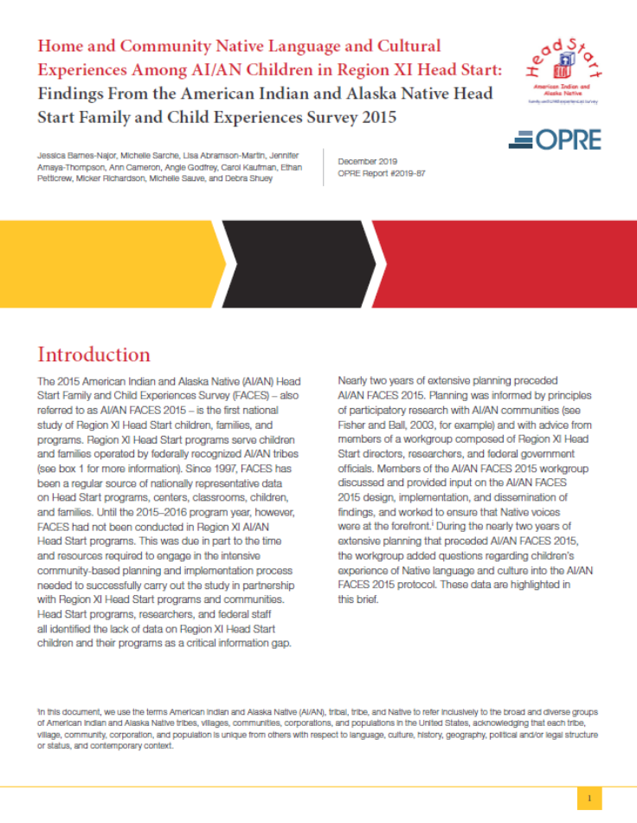
An Intergenerational Approach
Source: Office of Planning, Research & Evaluation. (2020). Home and Community Native Language and Cultural Experiences Among AI/AN Children in Region XI Head Start: Findings from the American Indian and Alaska Native Head Start Family and Child Experiences Survey 2015. U.S. Department of Health and Human Services, Administration for Children and Families. https://www.acf.hhs.gov/opre/resource/home-and-community-native-language-and-cultural-experiences-among-ai-an-children-in-region-xi-head-start ​
Notes:
Melody
There are a lot of takeaways from the findings from the AI/AN Head Start Family and Child Experiences Survey. Read slide.

Slide 19


Resource: Language for Life: Nourishing Indigenous Languages in the Home
Source: First Peoples’ Cultural Council. (2019). Language for Life: Nourishing Indigenous Languages in the Home. https://fpcc.ca/wp-content/uploads/2020/08/FPCC-LanguageforLife-190318-WEB.pdf
Notes:
Melody
Here is a resource with some ideas on how you can expand your language revitalization efforts to include multiple generations across multiple age groups. Read slide.

Slide 20
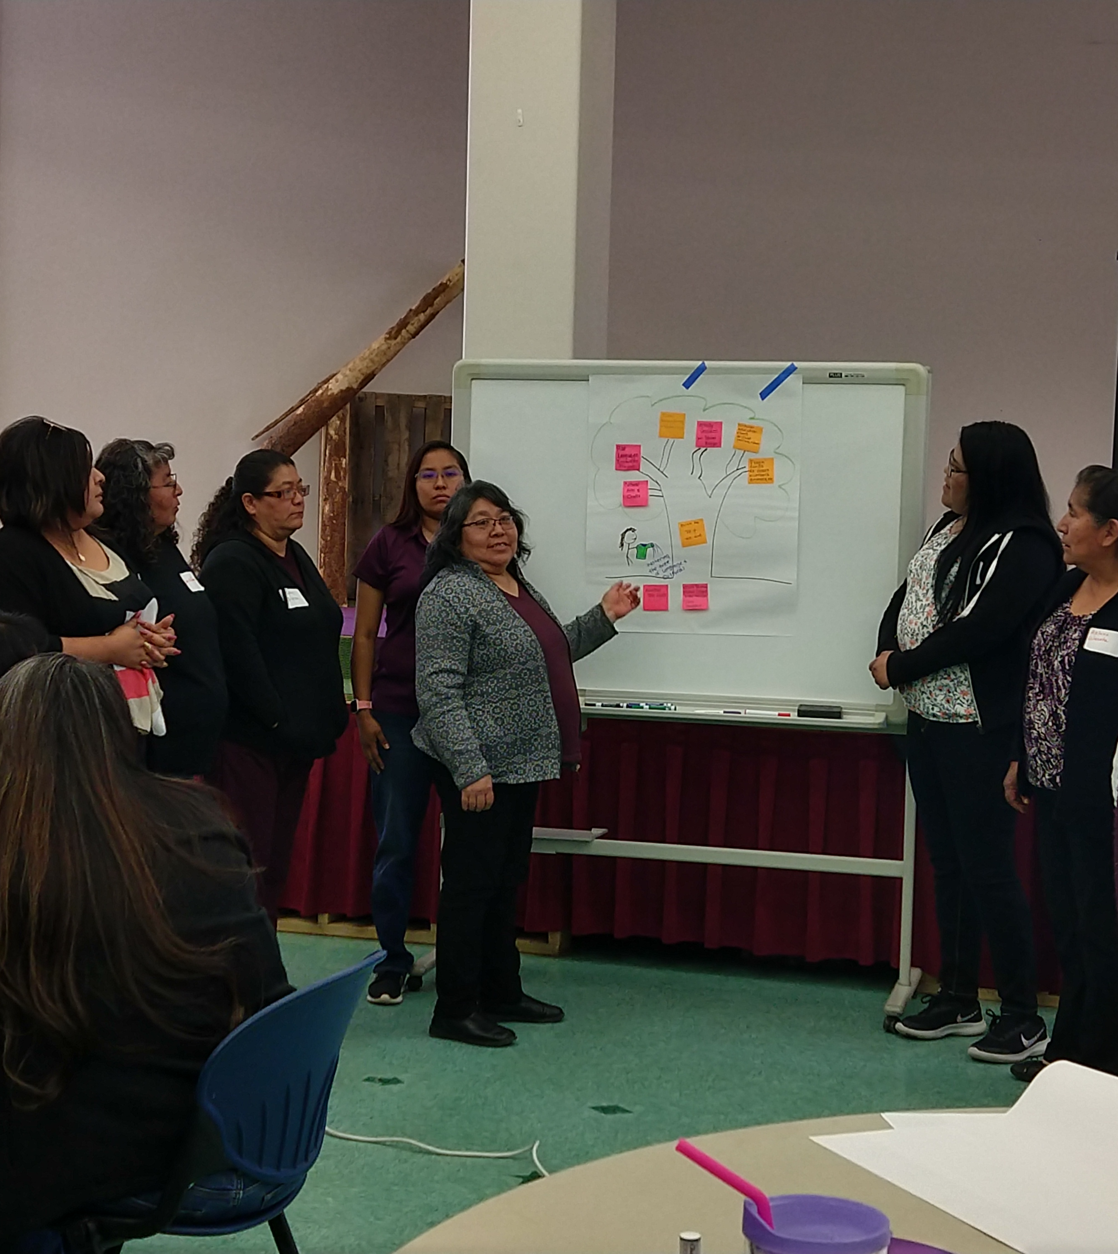
Community Events as a Strategy
Introduce adults and children to the Tribal language in a fun, enjoyable way
Participants control their own level of participation
Share knowledge
Notes:
Melody
Read slide.

Slide 21
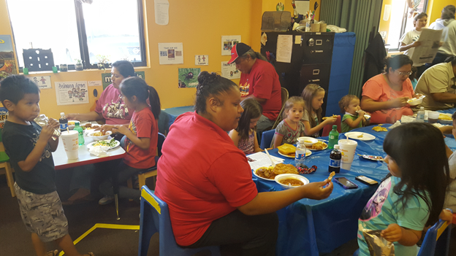
Community Events as a Strategy
Creates a safe space to practice and use the language
Helps maintain motivation to learn
Provides a multi-generational setting
Notes:
Melody
Read slide.

Slide 22

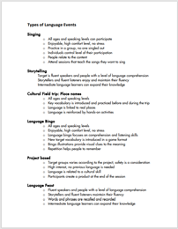
Resource:
Planning Community Language Events
Source: Chief Atahm School. (2018). Planning Community Language Events. Adams Lake Indian Band, First Peoples’ Cultural Council. https://fpcc.ca/wp-content/uploads/2020/08/FPCC-LanguageforLife-190318-WEB.pdf
Notes:
Melody
Here is another resource to consider with some ideas for planning language revitalization events in your community or program. Read slide.

Slide 23
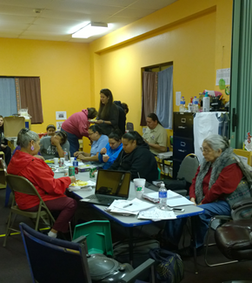
Types of Events
Singing
Storytelling
Cultural field trips
Place names
Language games
Language projects
Community meal or feast
Notes:
Melody
Read slide.
Focus on using immersion methods throughout the day, whether in the program or at home. We can also emphasize two Tribal Nations that have worked hard to deliver language immersion as a strategy specifically with their home providers, namely Northern Cheyenne CCDF and Zuni CCDF, who have both implemented quality initiatives that involve language immersion in the home.

Slide 24
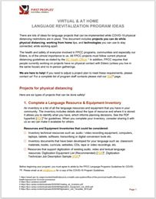
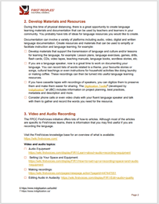
Resource: Virtual and At Home Language Revitalization Program Ideas
Source: First Peoples’ Cultural Council. (2019). Virtual and At Home Language Revitalization Program Ideas. https://fpcc.ca/wp-content/uploads/2020/08/FPCC-LanguageforLife-190318-WEB.pdf
Notes:
Melody
While many programs are having to be flexible with their activities, here are some ideas to consider. Read slide.

Slide 25
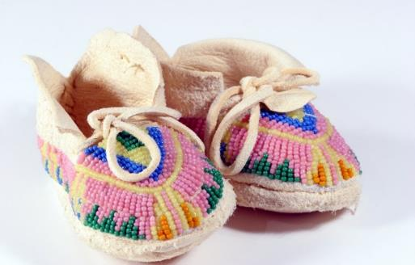
Child Care and Development Fund (CCDF) as a Strategy
All Tribal grantees are required to spend a percentage of their total CCDF expenditures on “activities designed to improve the quality of child care services and increase parental options for, and access to high-quality child care.”
Language Revitalization efforts would be considered as a way to improve the quality of child care services for children up to age 13.
Source: Child Care and Development Fund, 45 C.F.R. § 98.83(g)(1) (2016).
Notes:
Char
Child Care and Development Fund (CCDF) as a Strategy
All Tribal grantees are required to spend a percentage of their total CCDF expenditures on “activities designed to improve the quality of child care services and increase parental options for, and access to high-quality child care.”
Language Revitalization efforts would be considered as a way to improve the quality of child care services for children up to age 13.
Tribes who have a Child Care and Development Fund (CCDF) program may partner with the CCDF Tribal Lead Agency to utilize quality funds to implement a language revitalization effort.

Slide 26
Implementing Language Revitalization Using CCDF Funds
FY2020-2022 CCDF Plan
Long-Term Goal
Short-Term Objectives
Source: National Center on Tribal Early Childhood Development & State Capacity Building Center. (2019). Planning to Action: Implementing Management Systems and Strategic Planning in CCDF Tribal Lead Agencies [PowerPoint slides]. https://childcareta.acf.hhs.gov/sites/default/files/public/from_planning_to_action_-_implementing_management_systems_and_strategic_planning_in_ccdf_tribal_lead_agencies.pdf
Notes:
Char
To begin this effort or initiative, the first step would be to revisit the Tribe’s FY2020-2022 Tribal CCDF Plan to identify the quality activities the Tribal Lead Agency has chosen to implement. Some possible activities within the plan that could support a language revitalization effort are; training and professional development to ensure staff and providers are trained to implement language into the program, improving early learning and developmental guidelines to include cultural language milestones for children, improving the supply and quality of child care services for infants and toddlers, and the “other” category around culturally relevant activities. Just a quick reminder, if an activity is not included in the plan, the Tribal Lead Agency may amend their plan to include it within 60 days of the change.
The second step in the implementation process is to develop some long-term goals, what level of quality in child care settings do you wish to see once the initiative is complete? For example, a long term goal could be that infants and toddlers attending your Tribally Operated Center and Early Head Start program will be exposed to your Tribal language throughout the hours of care.
The third box, short-term objectives represent the small steps you will take to reach your long-term goal. Using the long term goal in the example just mentioned, some short term objectives may be:
Identify fluent language speakers in your community
Identify language speakers who currently work at the Tribally operated center or EHS program
Develop training opportunities for your infant and toddler teachers
Develop a coaching/mentoring program to support the teachers
Etc.
Let’s go to the next slide and think about a timeline for such activities.

Slide 27
Timelines
Year 1
Year 2
Year 3
Notes:
Char
As you heard in the last slide, there are many steps in developing a language revitalization effort and may take many years to fully implement. For example, year one could consist of planning, meeting with parents of children receiving CCDF funds or parents of children in early care and education programs in the community, elders in the community, child care providers, K-12 school personnel, and Tribal leadership to develop your long-term goal and some short-term objectives. In year 2, you could implement your short term objectives and finally in year 3, evaluate the outcome of your objectives, and develop new short-term objectives based on your findings.
The beauty of the process is that it can start small and grow over time, or it could enhance something that you have already begun.

Slide 28
Partnership Considerations
Notes:
Char
We want you to remember, that an individual program does not have to do it alone.
So let’s begin our discussion on partnership considerations.

Slide 29
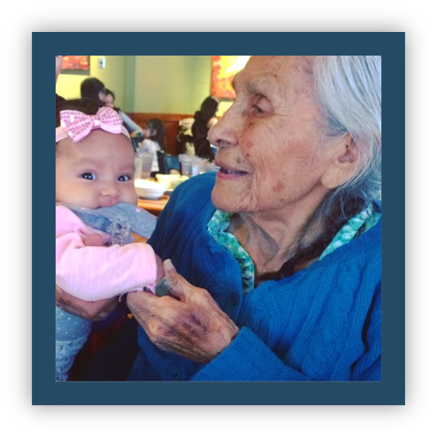
Considerations
Partner with families
Consult with elders and knowledge keepers
Collaborate with language and culture programs
Coordinate across age groups
Connect with child care providers, especially relative care providers
Notes:
Char
Some possible partners could include:
Partnering with families
Consulting with elders and knowledge keepers
Collaborating with language and culture programs
Coordinating across age groups
Connecting with child care providers, especially relative care providers

Slide 30

Partnership Considerations
When developing partnerships, include the local Tribal Lead Agency that can support both Native and non-Native providers caring for Native children via
  Language and Culture resources
  Elders in Classrooms
  Language Coordinator
  Other quality supports
Notes:
Char
Read slide.

Slide 31

Additional Considerations
Tribal CCDF Programs
Tribal Head Start or Early Head Start Programs
Tribal Museums
Boys & Girls Clubs
K-12 Schools
Tribal Pow Wow Organizations
Notes:
Char
Additional consideration include
Tribal CCDF Programs
Tribal Head Start or Early Head Start Programs
Tribal Museums
Boys & Girls Clubs
K-12 Schools
Tribal Pow Wow Organizations

Slide 32
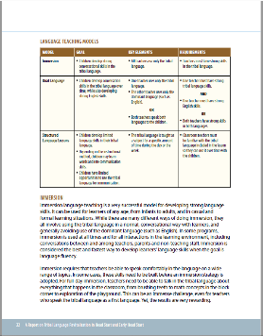
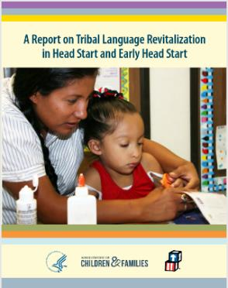
Resource: A Report on Tribal Language Revitalization in Head Start and Early Head Start
Source: National Center on Cultural and Linguistic Responsiveness. (2015). A Report on Tribal Language Revitalization in Head Start and Early Head Start. U.S. Department of Health and Human Services, Administration for Children and Families, Office of Head Start. https://eclkc.ohs.acf.hhs.gov/sites/default/files/pdf/report-tribal-language-revitalization.pdf
Notes:
Char
In 2016, the US Dept HHS Administration of Children and Families (ACF) Office of Head Start released A Report on Tribal Language Revitalization in Head Start and Early Head Start.
17 Tribes’ early childhood education programs are highlighted in the report for their strengths in language revitalization with young children
and this leads to positive early childhood education outcomes.
Here are some programs that contributed to this report:
Lac Courte Oreilles Band of Lake Superior Chippewa Indians Waadookodaading Ojibwe Language Immersion School,
Cherokee Nation Early Childhood Unit Head Start: Head Start and Early Head Start Cherokee Nation Immersion School,
Cochiti Pueblo Keres Children’s Learning Center,
Confederated Tribes of the Colville Reservation Head Start Early Childhood Inchelium Immersion Childcare Program Hearts Gathered Waterfall Immersion School,
Cook Inlet Native Head Start Early Head Start and Head Start,
Grassroots Indigenous Multimedia Ojibwe/Dakota Immersion games and songs workshop,
Hoopa Valley Tribe Early Head Start and Head Start
Jemez Pueblo Walatowa Head Start: Early Head Start and Head Start,
Karuk Tribe Head Start,
Makah Tribe, Early Childhood Education: Early Head Start, Head Start and Childcare,
Mille Lacs Band Of Ojibwe Head Start Immersion Classroom,
Red Cliff Band of Lake Superior Ojibwe Red Cliff Early Childhood Center (ECC): Early Head Start and Head Start,
Saint Regis Mohawk Tribe Early Childhood Development Program: Early Head Start and Head Start,
Smith River Rancheria Howonquet Head Start,
Standing Rock Sioux 0–5 Head Start: Early Head Start and Head Start,
Tlingit and Haida Tribes of Alaska Sitka Head Start Center
Juneau Head Start Centers Glacier Valley Elementary School Cultural Enrichment immersion class,
White Earth Nation White Earth Head Start/Early Head Start Programs

Slide 33
Poll / Discussion Question
B-5: If working with Birth to 5, in what ways are you partnering with K-12?
K-12: If working with K-12, in what ways are you partnering with Birth to 5?
Connecting: What strategies could you use to connect Birth-5 and K-12?
Notes:
Char

Slide 34

Next Steps
Notes:
Char
Now let’s think about next steps
What would you like to see begin or continue in your Tribal community. We would love for you to share your thoughts in the chat box. Many times some of our greatest ideas come from something someone has shared with you.

Slide 35
Resources
Notes:
Char

Slide 36
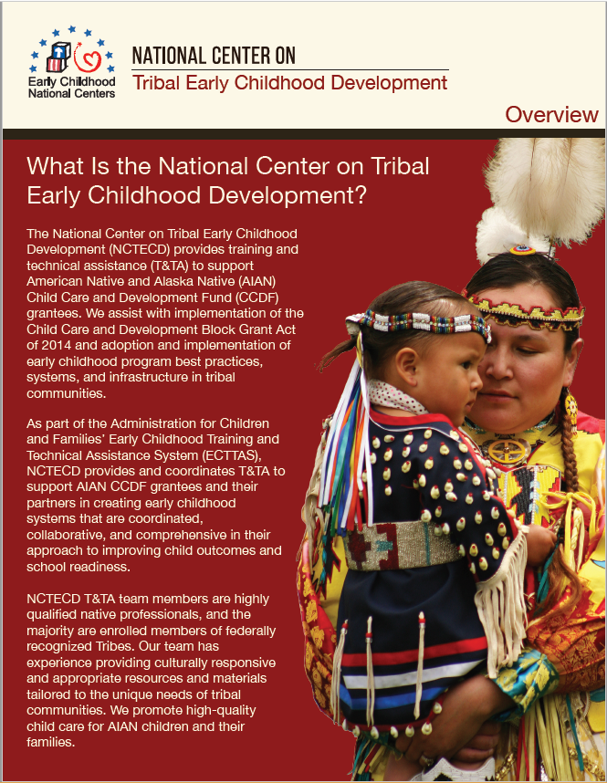
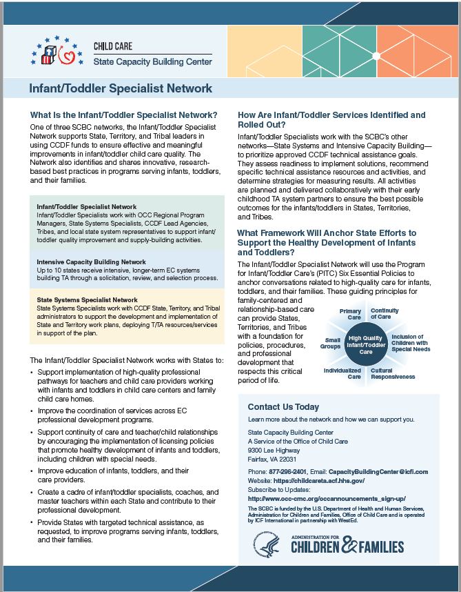
https://childcareta.acf.hhs.gov/centers/national-center-tribal-early-childhood-development
https://childcareta.acf.hhs.gov/infant-toddler-resource-guide/topic-overview-0
Notes:
Char
If you would like additional resources or supports, feel free to reach out to us.

Slide 37

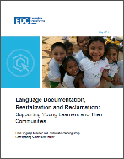
Resources
Resource | Source | Image
Culture and Language | Early Childhood Learning and Knowledge Center (ECLKC), https://eclkc.ohs.acf.hhs.gov/culture-language
Language Documentation, Revitalization, and Reclamation: Supporting Young Learners and Their Communities | Child Language Research and Revitalization Working Group. (2017). https://www.edc.org/sites/default/files/uploads/RouvierWhitePaperFinal.pdf
Notes:
Char

Slide 38
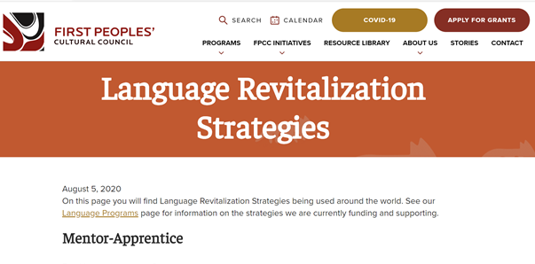
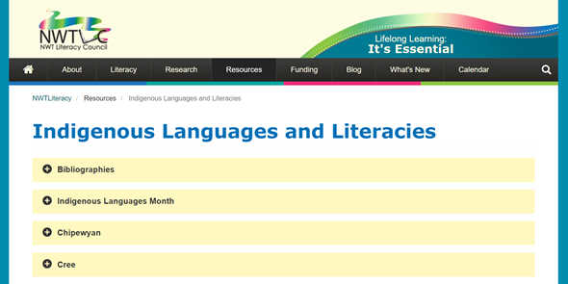
Resources
Resource | Source | Image
Language Revitalization Strategies | The First Peoples’ Cultural Council has many resources related to various language revitalization strategies such as immersion, language nests, culture camps, language documentation, etc. https://fpcc.ca/resource/language-revitalization-strategies/
Indigenous Languages and Literacies | Northwest Territories Literacy Council has various language revitalization strategies in their resource page for families, communities, and program staff. https://www.nwtliteracy.ca/index.php/resources/indigenous-languages-and-literacies
Notes:
Char

Slide 39
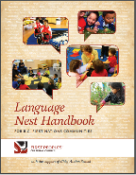
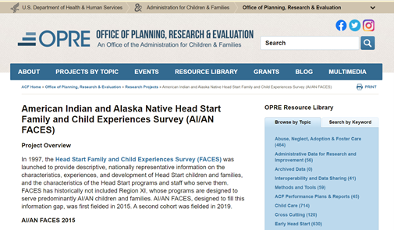
Featured Resources
Resource | Source | Image
Language Nest Handbook from the First People’s Cultural Council | This handbook has been developed for First Nations communities who are currently running a language nest program, as well as for communities who wish to start up a language nest. https://fpcc.ca/resource/language-nest-handbook/
ACF OPRE American Indian and Alaska Native (AI/AN) Family and Child Experiences Survey Data | The ACF Office of Planning, Research, and Evaluation (OPRE) maintains research on Tribal language and culture use in American Indian and Alaska Native (AI/AN) Head Start and Early Head Start programs. https://www.acf.hhs.gov/opre/research/project/american-indian-and-alaska-native-head-start-family-and-child-experiences-survey-faces
Notes:
Char

Slide 40
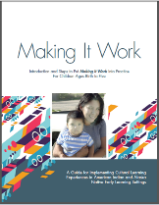
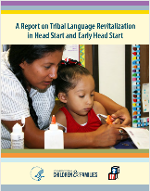
Featured Resources
Resource | Source | Image
Making It Work: Implementing Cultural Learning Experiences in American Indian and Alaska Native Early Learning Settings for Children Ages Birth to 5 | National Center on Early Childhood Development, Teaching, and Learning, retrieved from https://eclkc.ohs.acf.hhs.gov/sites/default/files/pdf/no-search/making-it-work-2017.pdf
Report on Tribal Language Revitalization in Head Start and Early Head Start | Administration for Children and Families (ACF) Office of Head Start and Early Head Start. (2015). https://eclkc.ohs.acf.hhs.gov/sites/default/files/pdf/report-tribal-language-revitalization.pdf
Notes:
Char

Slide 41
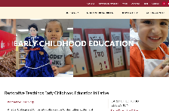
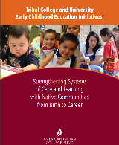
Featured Resources
Resource | Source | Image
Restorative Teachings in Early Childhood Education Initiatives | American Indian College Fund https://collegefund.org/research-and-programs/early-childhood-education/restorative-teachings-early-childhood-education-initiative/
Tribal College and University Early Childhood Education Initiatives: Strengthening Systems of Care and Learning with Native Communities from Birth to Career | American Indian College Fund Tribal College and University Early Childhood Education Initiatives http://collegefund.org/wp-content/uploads/2019/12/Early-Childhood-Education-Initiatives_B.pdf
Notes:
Char

Slide 42
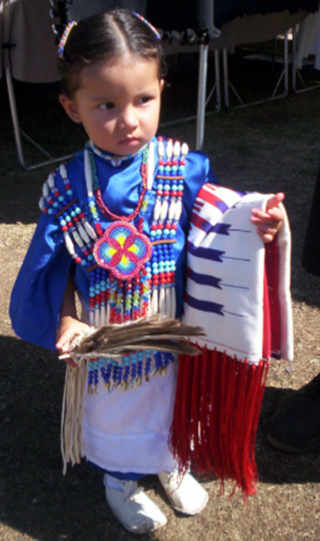
Ah-hoh! Thank you!
“Let us put our minds together and see what life we can make for our children.”
Sitting Bull, Dakota Sioux
Notes:
Char
“Let us put our minds together and see what life we can make for our children.” a quote from Sitting Bull , Dakota Sioux
This quote helps us remember that it is important to work together to make the life you want for your Tribal children.
These partnerships can also provide language revitalization supports to foster families and child care professionals who care for Tribal children.

Slide 43

Contact Information
Melody Redbird-Post, Project Director
National Center on Tribal Early Childhood Development
Melody.Redbird-Post@icf.com
Char Schank, Technical Assistance Coordinator
National Center on Tribal Early Childhood Development
Char.Schank@icf.com
Lisa Ojibway, Infant/Toddler Specialist
Child Care State Capacity Building Center
Lisa.Ojibway@icf.com
Thank you!
Notes:
Char

Slide 44

National Center on Tribal Early Childhood Development,
A Service of the Office of Child Care
9300 Lee Highway
Fairfax, VA 22031
Phone: 877-296-2401
Email: nctecd@ecetta.info
State Capacity Building Center,
A Service of the Office of Child Care
9300 Lee Highway
Fairfax, VA 22031
Phone: 877-296-2401
Email: CapacityBuildingCenter@ecetta.info
Subscribe to Updates
http://www.occ-cmc.org/occannouncements_sign-up/
Notes:
Char

